Slide 1
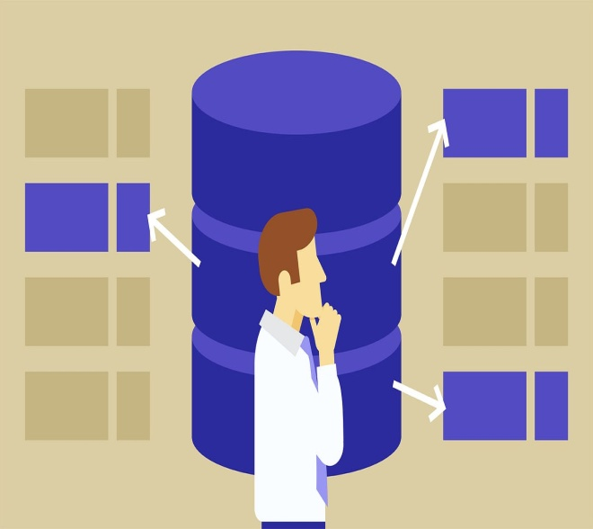
Normalization
Database Management System(DBMS)
By Sandipa Shrestha
From BCSIT-III

Slide 2

Introduction
Normalization is the process of organizing the data in the database.
Normalization is used to minimize the redundancy from a relation or set of relations. It is also used to eliminate undesirable characteristics like Insertion, Update, and Deletion Anomalies.
Normalization divides the larger table into smaller and links them using relationships.
The normal form is used to reduce redundancy from the database table.

Slide 3
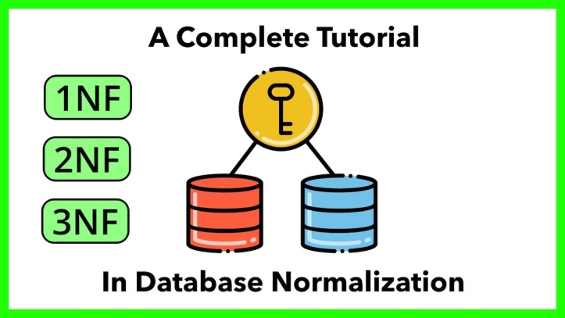
Types Of Normal Forms
1NF
2NF
3NF
BCNF (Boyce Codd’s Normal Form)
4NF
5NF

Slide 4
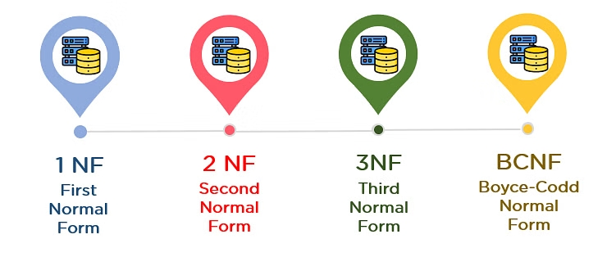
Normal Forms

Slide 5
Normal forms:
Normal Form | Description
1NF | A relation is in 1NF if it contains an atomic value.
2NF | A relation will be in 2NF if it is in 1NF and all non-key attributes are fully functional dependent on the primary key.
3NF | A relation will be in 3NF if it is in 2NF and no transition dependency exists.
BCNF | A stronger definition of 3NF is known as Boyce Codd's normal form.

Slide 6
The First Normal Form – 1NF
a single cell must not hold more than one value (atomicity) n 1NF, all columns must contain atomic (indivisible) values. In the original table, the Orders1 and Order2 columns contain compound values (i.e., the product name, quantity, and price are combined into a single field).
there must be a primary key for identification
no duplicated rows or columns
each column must have only one value for each row in the table

Slide 7
Example of 1NF:Atomicity (no repeating groups)
+---------------+-----------------+------------------+---------------------------+-------------------------------+
| CustomerID | Name | Address | Orders1 | Order 2 |
+--------------+------------------+------------------+-----------------------------+-------------------------------+
| 1 | Ram Shrestha | Kathmand | Order1: Rice, 5kg, 600 | Order2: Oil, 1L, 250 |
| 2 | Sita Lama | Bhaktapur | Order1: Sugar, 3kg, 150 | Order2: Tea, 1pkt, 100 |
| 3 | Hari Gurung | Pokhara | Order1: Salt, 2kg, 60 | Order2: Coffee, 1pkt, 500 |
| 4 | Gita Magar | Lalitpur | Order1: Dal, 2kg, 400 | Order2: Ghee, 1kg, 1000 |
+----------------+----------------+------------------+------------------------------+--------------------------------+
Solution:
In 1NF, all columns must contain atomic (indivisible) values. In the original table, the Orders1 and Order2 columns contain compound values (i.e., the product name, quantity, and price are combined into a single field).

Slide 8
Customer Id | Name | Address | Order ID | Product | Quantity | Price
1 | Ram Shrestha | Kathmandu | 1 | Rice | 5Kg | 600
1 | Ram Shrestha | Kathmandu | 2 | Oil | 1L | 250
2 | Sita Lama | Bhaktapur | 1 | sugar | 3Kg | 150
2 | Sita Lama | Bhaktapur | 2 | tea | 1pkt | 100
3 | Hari Gurung | Pokhara | 1 | salt | 2Kg | 60
3 | Hari Gurung | Pokhara | 2 | coffee | 1pkt | 500
4 | Gita Magar | Lalitpur | 1 | Dal | 2Kg | 400
4 | Gita Magar | Lalitpur | 2 | Ghee | 1kg | 1000

Slide 9
The Second Normal Form – 2NF
The 1NF only eliminates repeating groups, not redundancy. That’s why there is 2NF.
A table is said to be in 2NF if it meets the following criteria:
it’s already in 1NF
has no partial dependency. That is, all non-key attributes are fully dependent on a primary key.

Slide 10
Normalize Table Of 2NF:
Customer Table(stores only customer info)
2NF::
Customer ID | Name | Address
1 | Ram Shrestha | Kathmandu
2 | Sita Lama | Bhaktapur
3 | Hari Gurung | Pokhara
4 | Gita Magar | Lalitpur

Slide 11
2. Order Table
Customer Id | Order ID | Product | Quantity | Price
1 | 1 | Rice | 5kg | 600
1 | 2 | oil | 1L | 250
2 | 1 | sugar | 3kg | 150
2 | 2 | tea | 1pkt | 100
3 | 1 | salt | 2kg | 60
3 | 2 | coffee | 1pkt | 500
4 | 1 | dal | 2kg | 400
4 | 2 | ghee | 1kg | 1000

Slide 12
The Third Normal Form – 3NF
When a table is in 2NF, it eliminates repeating groups and redundancy, but it does not eliminate transitive partial dependency.
This means a non-prime attribute (an attribute that is not part of the candidate’s key) is dependent on another non-prime attribute. This is what the third normal form (3NF) eliminates.
So, for a table to be in 3NF, it must:
be in 2NF
have no transitive partial dependency.

Slide 13
Normalize Table in 3NF
Customer Table
Customer ID | Name | Address
1 | Ram Shrestha | Kathmandu
2 | Sita Lama | Bhaktapur
3 | Hari Gurung | Pokhara
4 | Gita Magar | Lalitpur

Slide 14
2. Order Table
Customer Id | Order ID | Product | Quantity | Price
1 | 1 | Rice | 5kg | 600
1 | 2 | oil | 1L | 250
2 | 1 | sugar | 3kg | 150
2 | 2 | tea | 1pkt | 100
3 | 1 | salt | 2kg | 60
3 | 2 | coffee | 1pkt | 500
4 | 1 | dal | 2kg | 400
4 | 2 | ghee | 1kg | 1000

Slide 15
BCNF (Boyce-Codd Normal Form)
1NF
Customer ID | Name | Address | Order ID | Product | Quantity | Price
2NF
Student Table:
Order Table:
Customer ID | Name | Address
Order ID | Product | Quantity | Price
Student Table:
Customer ID | Name | Address | Order ID

Slide 16
2NF
Customer ID | Name | Address | Order ID
3NF
Customer ID:
Customer Id | Name | Address
Order ID:
Order ID | Product | Quantity | Price

Slide 17
Normalize Table in BCNF(same as 3NF):
Customer Table
Customer ID | Name | Address
1 | Ram Shrestha | Kathmandu
2 | Sita Lama | Bhaktapur
3 | Hari Gurung | Pokhara
4 | Gita Magar | Lalitpur

Slide 18
2. Order Table
Customer Id | Order ID | Product | Quantity | Price
1 | 1 | Rice | 5kg | 600
1 | 2 | oil | 1L | 250
2 | 1 | sugar | 3kg | 150
2 | 2 | tea | 1pkt | 100
3 | 1 | salt | 2kg | 60
3 | 2 | coffee | 1pkt | 500
4 | 1 | dal | 2kg | 400
4 | 2 | ghee | 1kg | 1000

Slide 19
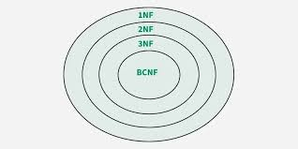
A relation in BCNF,
is also in 3NF.
A relation in 3NF,
is also in 2NF.
A relation in 2NF,
is also in 1NF.

Slide 20
1NF | 2nf | 3NF | BCNF
Atomicity | Functional dependency (no partial dependency) | Not Transitive Dependency | X Y X is a super key 0% redundancy (due to functional dependency)

Slide 21
Conclusion
1NF: Atomicity (no repeating groups).
• 2NF: No partial dependencies (all non-key attributes depend on the whole key).
• 3NF: No transitive dependencies (non-key attributes depend only on the key).
• BCNF: Every determinant is a super key.

Slide 22

Any Question

Slide 23


